Slide 1
Ultra high brightness photoinjector for EBTF/CLARA facility at Daresbury
B.L. Militsyn
on behalf of the ASTeC photoinjector development team
Accelerator Science and Technology Centre
Science & Technology Facility Council,
Daresbury, UK

Slide 2
Daresbury Science and Innovation Campus, Daresbury, Cheshire, UK

Slide 3
Outline
High brightness Electron Beam Test Facility (EBTF)
EBTF photoinjector
Photocathode gun
Beam dynamic simulations
Metal photocathode research program
Laser system
Beam diagnostic
RF system
CLARA – ultra short pulse high brightness research accelerator
Conclusion

Slide 4
Electron Beam Test Facility EBTF
Objective: To provide a suite of accelerator testing facilities which can be utilised in partnership with industry, academic and scientific collaborators
Scope: The provision of a common high performance and flexible injector facility comprising an RF gun, associated RF power systems, beam diagnostics and manipulators, a high power photo-injector drive laser and associated enclosures
Costs: £2.5M capital from DBIS has been assigned for this facility. This investment will be supplemented by £447k capital allocation from STFC’s baseline capital allocation for the accelerator test facilities
Timescales: Purchase the majority of the equipment in financial year 2011/12, with build in 2012. It is planned that first electrons from the facility are delivered in December 2012

Slide 5
EBTF beam parameters
Beam Energy | 4 ‐ 6.5 MeV
Bunch Charge (minimum) | ~1 pC - 20 pC | Electron diffraction CLARA
Bunch Charge (max) | 250 pC | Industrial users
Bunch length (rms) | 40 fsec | With 100 fsec FWHM laser pulse (at low bunch charge)
Normalised beam emittance (min – max) | 0.1 ‐ 2 mm⋅mrad | Depending on the bunch charge
RMS beam size (min‐max) | 0.1 ‐ 3.5 mm | Low‐high charge
Energy spread (maximum) | 3.3 % | changing due to space charge
RF repetition rate | 1 ‐ 400 Hz | Modulator 400 Hz
Maximum laser repetition rate | 1 kHz | Laser will be delivered with a repetition rate of 400 Hz.

Slide 6
General layout

Slide 7
Construction Modules
Module 4
Module 3
Module 5
Module 1
Module 6
Module 2

Slide 8
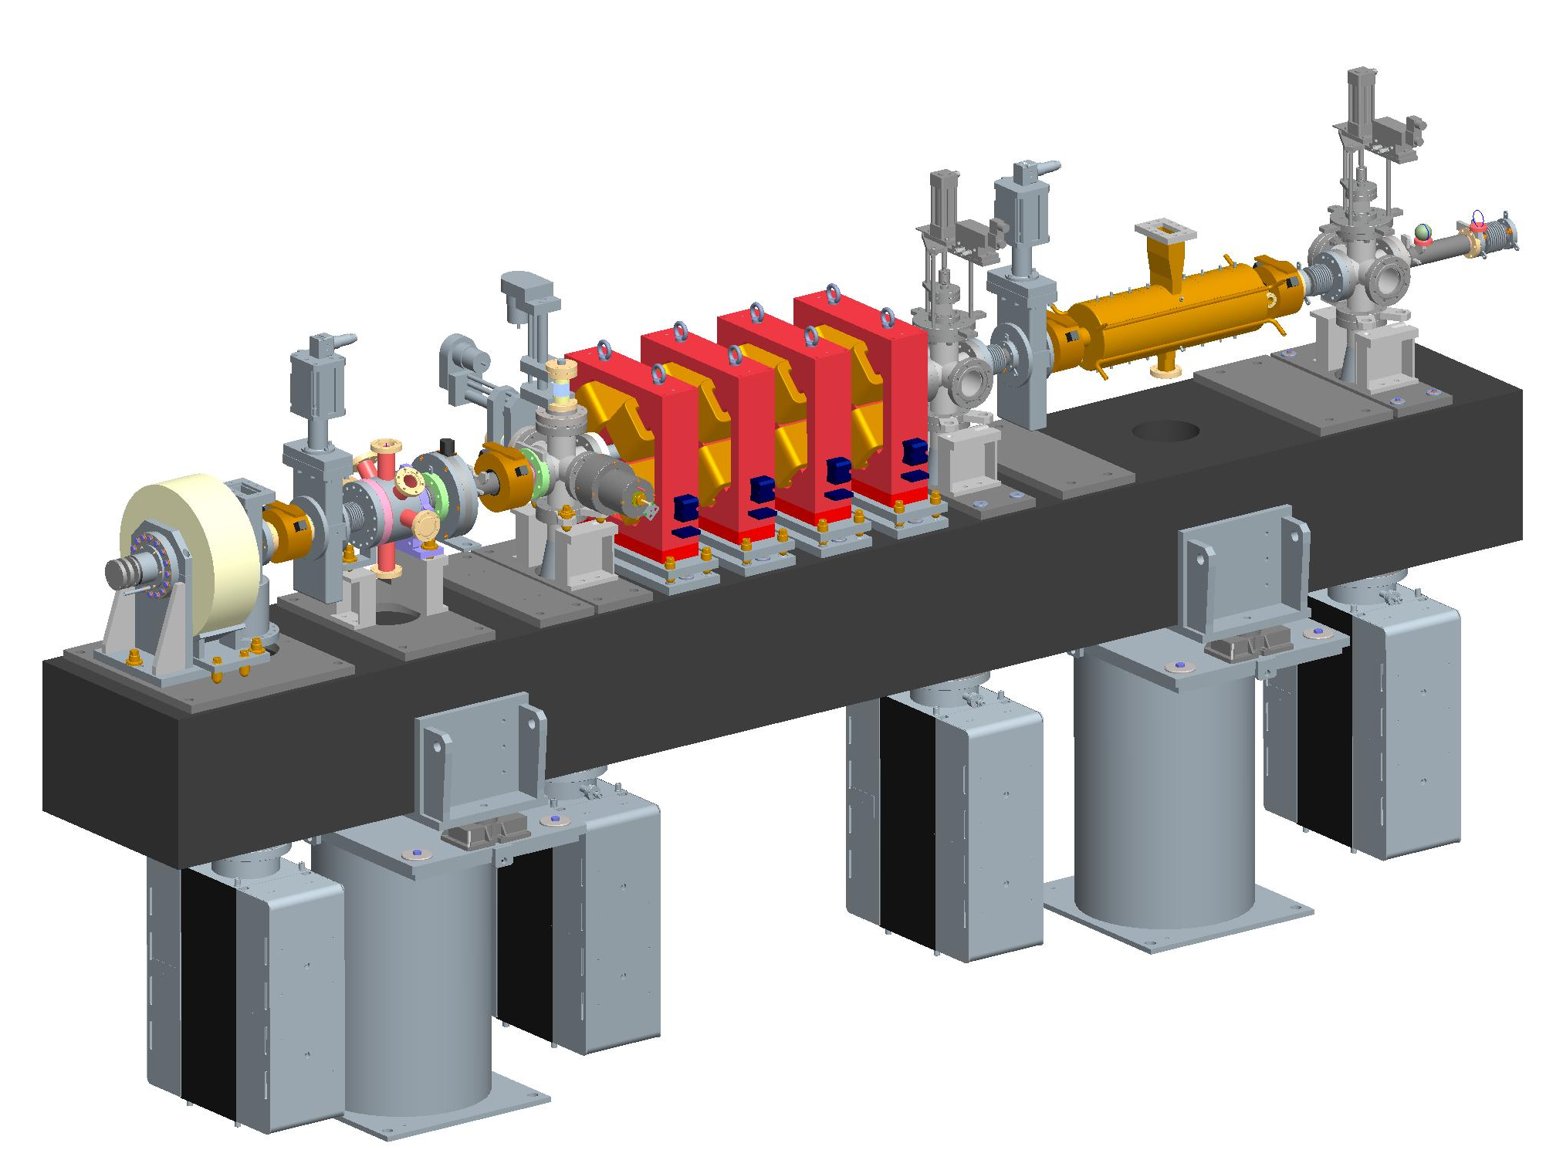
Photoinjector Module
YAG, V Slit
YAG, H & V Slit
Collimators
YAG, V & H Slit
Transverse Deflecting Cavity
Lightbox
Quadrupole magnets
WCM
Gun Solenoid
Synthetic Granite Girder
Support Pedestal
4 x Ion Pump

Slide 9
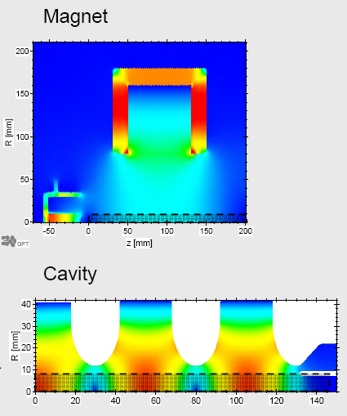
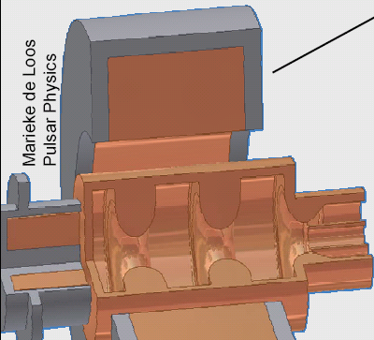
EBTF photoinjector based on the ALPHA-X 2.5-cell S-band gun (TU/e-Strathclyde-LAL)

Slide 10
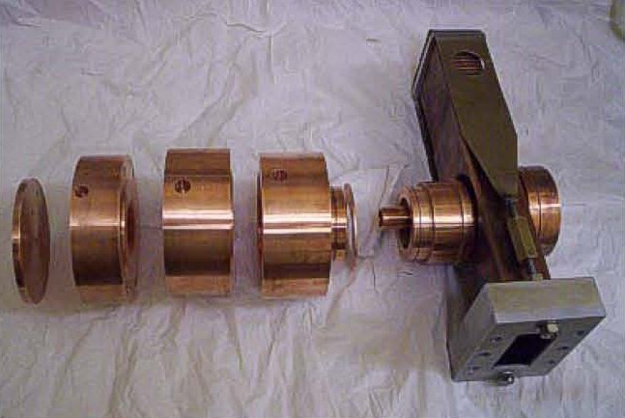
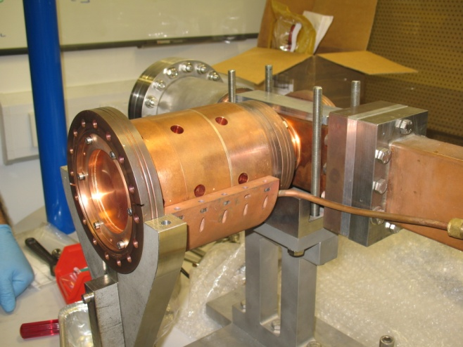
Photocathode gun cavity
Parameter | Value | Units
Frequency | 2998.5 | MHz
Bandwidth | < 5 | MHz
Maximum beam energy | 6 | MeV
Maximum accelerating field | 100 | MV/m
Peak RF Input Power | 10 | MW
Maximum repetition rate | 10 | Hz
Maximum bunch charge | 250 | pC
Operational Temperature | 30 - 45 | °C
Input coupling | WR284

Slide 11
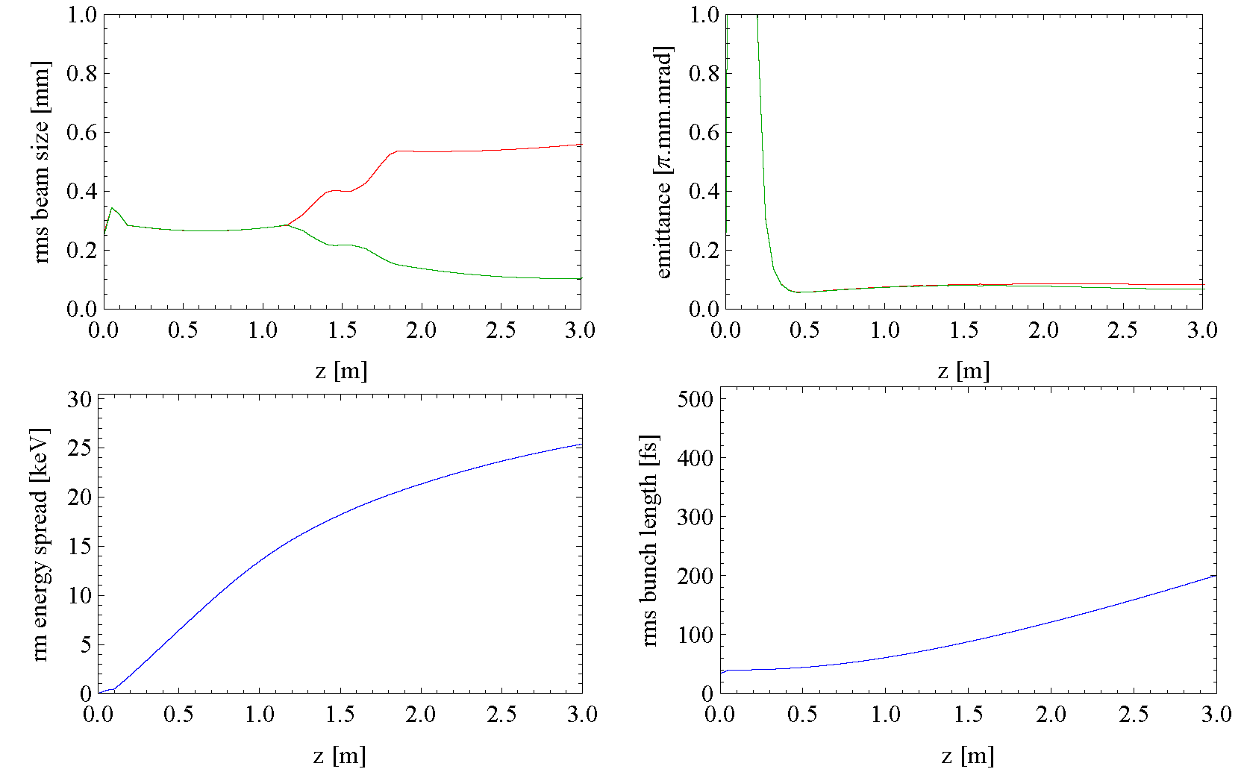
EBTF beam dynamics simulation. Bunch charge1pC, RMS laser pulse length 40fs

Slide 12
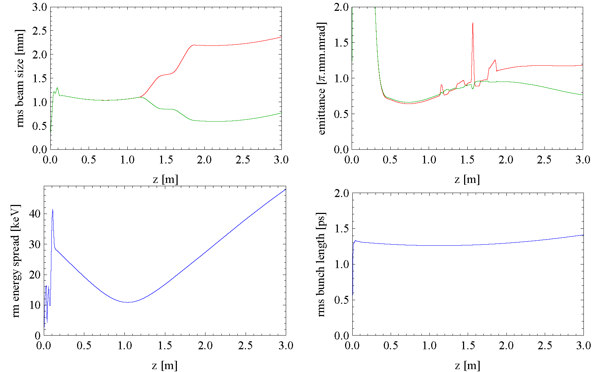
EBTF beam dynamics simulation. Bunch charge250 pC, RMS laser pulse length 40fs

Slide 13
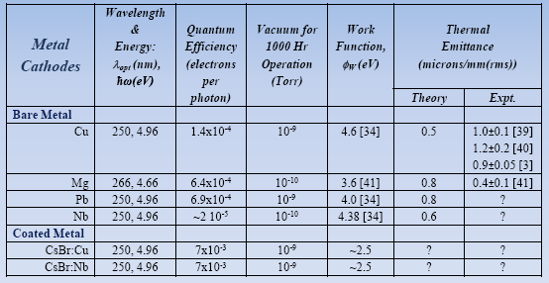
Metal Photocathodes
Metal cathodes have fast response time10⁻¹⁵ to 10⁻¹⁴ seconds.
They are robust and can survive months at high surface fields to produce high brightness beam
However due to the high work function an UV drive laser is required to achieve reasonable QE.

Slide 14
Photocathode performance research program
Photocathode performance
Establish reliable and reproducible sample preparation procedure to minimise the final surface contamination
Prepare atomic flat surfaces for single crystal and poly-crystalline copper
Produce and investigate engineered rough surface
Determine QE for different method of surface regeneration (Ar, H and Ozone cleaning)
Determination of surface roughness after each procedure
Identify the effect each individual residual gas species(H₂, CO, CO₂, H₂O and CH₃) on QE degradation
Optimization of wide band gap coating (CsBr) on copper
Study and optimisation of the photocathode operational environment
Investigation of the gas atmosphere in the operational gun
Definition of the gas spices, responsible for the photocathode degradation
Optimisation of the cavity preparation procedure to minimise photocathode degradation
Investigation of impact of the back stream bombardment on the photocathode lifetime
Design photoctahode transport system and study its effectiveness

Slide 15
Commissioning of the Photocathode Preparation and Characterisation Facility

Slide 16
Surface Science Analytical tools
Available in-situ in house:
X-ray Photoelectron spectroscopy (XPS) : to determine surface and near surface ( 9nm) chemical state
Auger Electron spectroscopy (AES)/ Mapping : to determine surface and near surface composition
Ion scattering spectroscopy (ISS): to determine surface composition
Ultraviolet Photon Spectroscopy (UPS): to determine the electronic structure of solids and the adsorption of relatively simple molecules on metals
In-situ UHV Atomic force /Scanning Tunnelling Microscope: to determine the surface topography.
Low Magnification (5000) SEM
Ar and H ion gun to clean the photocathode by ion bombardment
Direct Access at Universities:
High Resolution SEM to determine surface and depth structure.
Energy dispersive Spectroscopy (EDS): to determine in depth composition
Electron Backscattered Diffraction (EBDS) : to determine surface crystal structure and orientation.
X-ray Diffraction (XRD): To determine depth crystal structure and orientation, grain size and lattice strain.

Slide 17
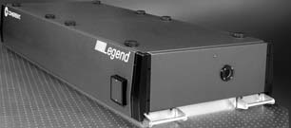
Drive laser system
Wavelength , nm | 266
Pulse energy, mJ | >1
Pulse duration, fs | < 100 FWHM
Pulse repetition rate, kHz | 1
Transverse beam quality M² | <1.5

Slide 18
RF Requirements
Parameter | Value | Units
Frequency | 2998.5 | MHz
Bandwidth (1 dB points) | <10 | MHz
Total peak output power | > 8 MW | MW
Power gain | > 45 | dB
Nominal efficiency | > 45 | %
Pulse Repetition Rate Range | 1 – 400 | Hz
RF Pulse Duration | <3.5 | µs
RF Flat Top Pulse Width | >2.5 | µs
Amplitude stability | 0.0001
Phase Stability | 0.1 | °
Noise Power Within the Bandwidth | < -60 | dB
Spurious Noise Power Outside the Bandwidth | < -35 dB | dB

Slide 19
TH 2157A Data Sheet
RF Performance | TH 2157 |  | TH 2157A | Units
Frequency | 2 998.5 | 2 998.5 | 2 998.5 | MHz
Output power:
• Peak | 5.5 | 7.5 | 10 | MW
• Average | 10 | 8 | 10 | kW
RF Pulse Width | 8 | 6 | 3.5 | μs | Max
Saturated Gain | 45 | 48 | 50 | dB | Min
Efficiency | 48 | 48 | 48 | % | Typ
Electrical characteristics
Cathode Voltage | 132 | 150 | 168 | kV | Typ
Beam Current | 86 | 105 | 124 | A | Typ
Heater Voltage | 15 | 15 | 15 | V | Max
Heater Current | 15 | 15 | 15 | A | Max

Slide 20
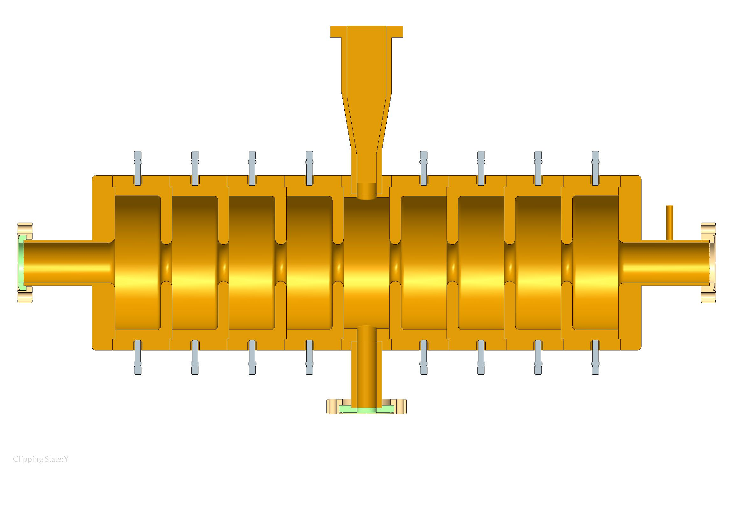
9 cell Transverse Deflecting Cavity
Input coupler
Tuning studs
CF70 entrance flange
CF70 exit flange
Dummy Load/Vacuum port

Slide 21
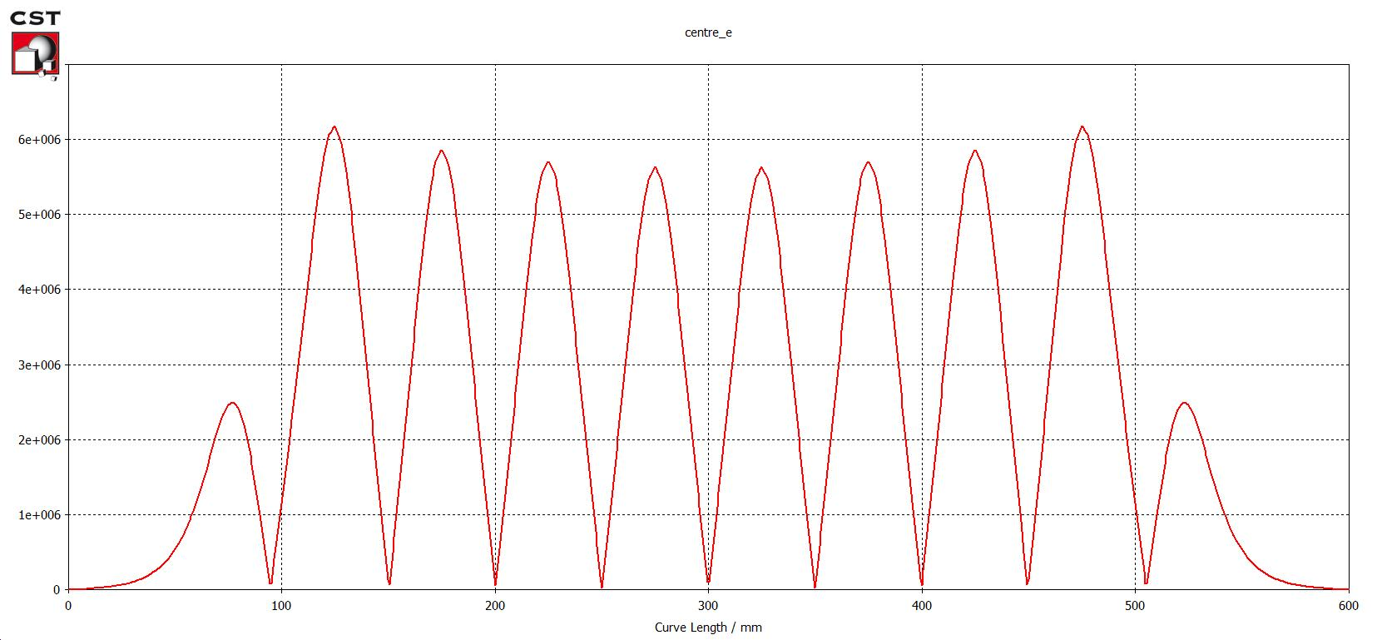
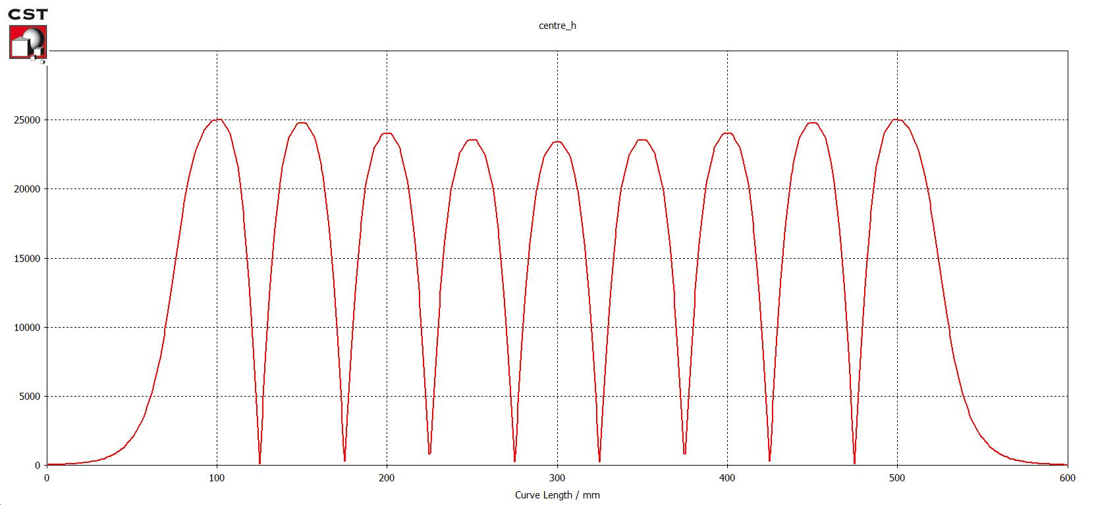
On-axis fields of the transverse deflecting cavity
Estimated peak transverse voltage 5 MV (limited by available RF power)
Estimated resolution at 25 MeV beam energy ~30fs
E-field
H-field

Slide 22
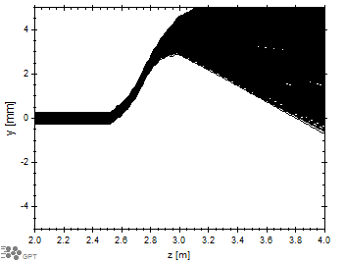
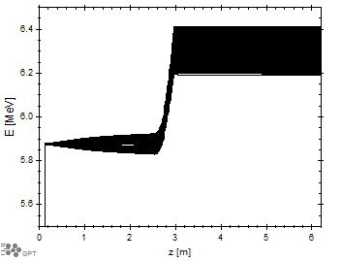
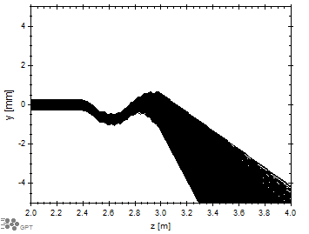
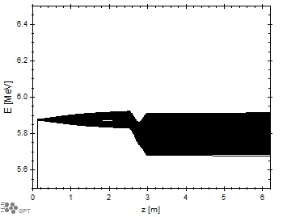
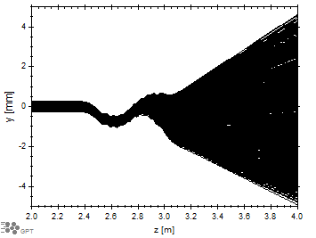
TDC at low beam energy
Vertical trajectories
Energy
TDC introduces vertical streak along length of bunch allowing bunch length to be measured.
However, it also produces unwanted vertical kick
Offset beam “sees” longitudinal fields, leading to energy variation.
No correctors
1st corrector
2nd corrector

Slide 23
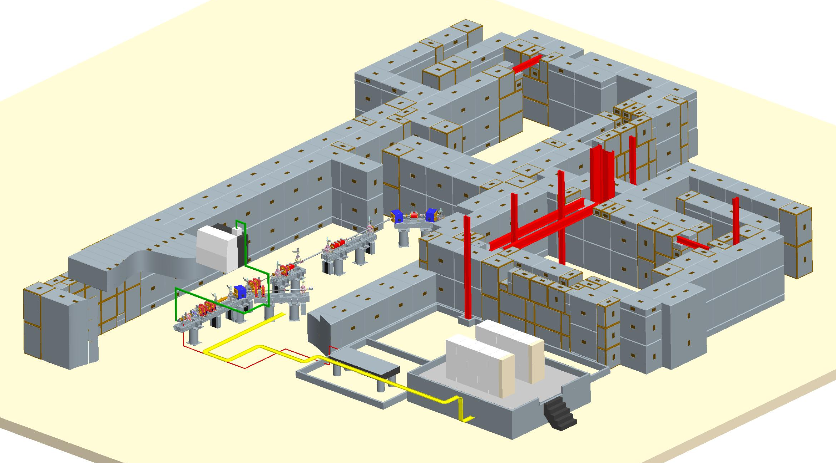
EBTF layout
CLARA expansion
pathway
User Area 1
User Area 2
Accelerator area
Laser room
Rack room

Slide 24
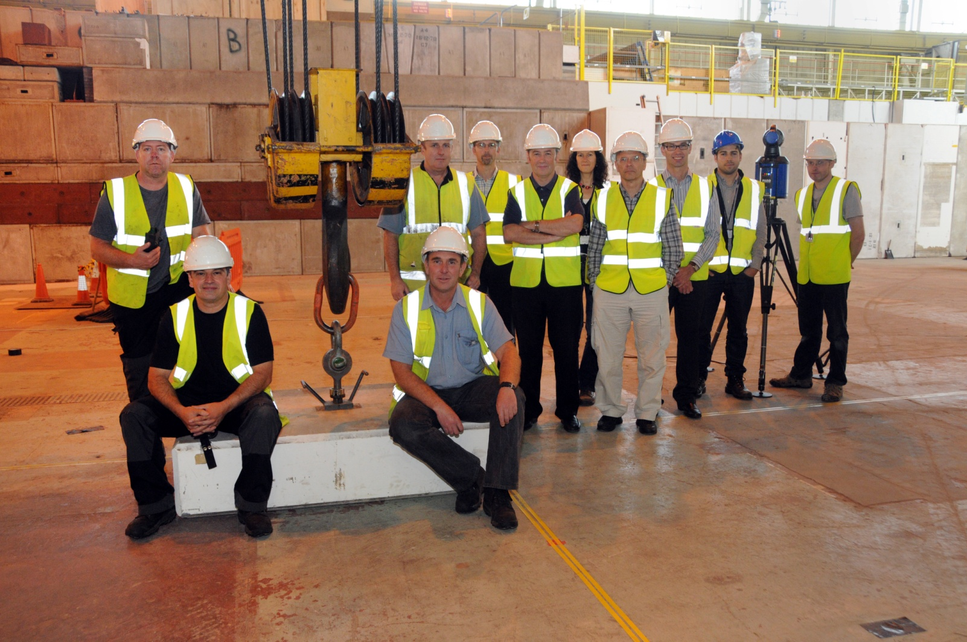
Positioning of the first block
Notes:
I would like to thanks all those involved in the project for their efforts so far. We have very aggressive timescales and targets to meet, this financial year in terms of spending the £2.5M from BIS, the building of the concrete infrastructure and services to the facility and next year

Slide 25
CLARA (preliminary layout)
Gun
Linac 1
Linac 2
Linac 3
Linac 4
5 MeV
10 MeV (bunching)
35 MeV (accelerating)
50 MeV
145 MeV
240MeV
Linac 1+2 are 2m S-band modules
Linac 3+4 are 5m S-band modules
Two stage compression
Velocity bunching
Magnetic chicane
Charge ranges from 10 pC – 250 pC
1 mm mrad and less emittance
300 A current over 300 fs bunch length for seeding schemes
Single-spike SASE, EEHG, HGHG, novel short pulse schemes

Slide 26
Preliminary Parameters of the CLARA FEL
Beam Energy ~250MeV
SASE Saturation length <15m
Seed with Ti:Sa 800nm, lase up to 8th harmonic
Seeding with HHG at 100nm also possible
Single spike SASE driven by electron bunches length ~50fs FWHM and charge <20pC
Seeding driven by electron bunches with a peak current ~400A, flat top ~300fs and charge <200pC

Slide 27
Conclusion
EBTF high brightness electron photoinjector is funded and under construction
Front end for ongoing project CLARA
Source of electrons for industrial and scientific users
Operation with ultra short bunches
Experiments with electron difraction
Photocathode research program
Metal photocathode development program has been started and successfully expanded

Slide 28
Thanks to:
D. Angal-Kalinin
C. Hill
S.P. Jamison
J.W. McKenzie
K.J. Middleman
M.D. Roper
R.J. Smith
B.J.A. Shepherd
R. Valizadeh
A.E. Wheelhouse

Slide 29
Thank you for your attention!

